Slide 1
Unit 3
Chapter 5
Lesson 1
Day 3
Pages 126-132; 145-146

Slide 2
Possible Sentences
Use the following words to write three sentences that could possibly be from today’s lesson. Each sentence should contain one of the words.
experiment invited privileges
Share your sentences with your partner.

Slide 3
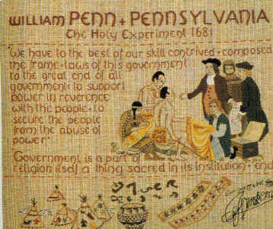
Penn called Pennsylvania a “holy experiment” because the colony was based on his Quaker beliefs.

Slide 4
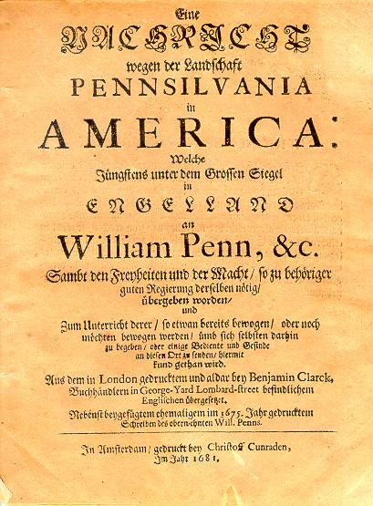
Penn wanted to treat everyone fairly in his new colony, so he sold land to people at good prices. He also invited people from different European countries to live in Pennsylvania.

Slide 5
Quote and Comment
*Read the quote in the yellow box on pg. 129.
*Imagine you lived in another country many years ago. Would you want to move to the new colony of Pennsylvania? Write three lines explaining your feelings.
Share what you wrote with your partner.

Slide 6
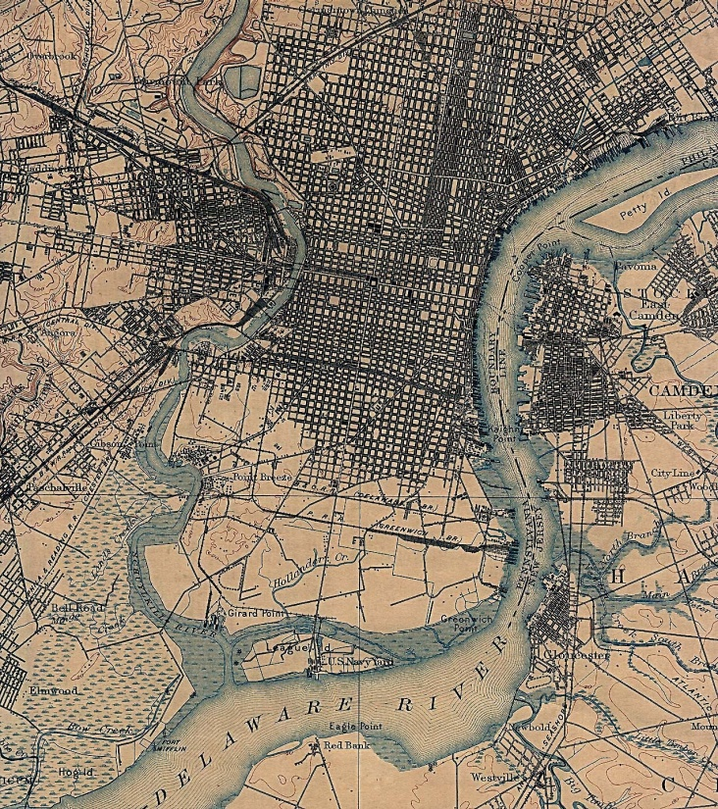
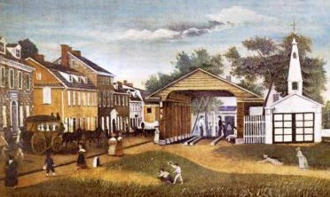
One group made up of 13 German families came to Pennsylvania in 1683 and settled near Philadelphia. They named their town Germantown.

Slide 7
Many Germans would come and settle in the colony over the years. By the 1750s, more than ½ the population of Pennsylvania spoke German.

Slide 8
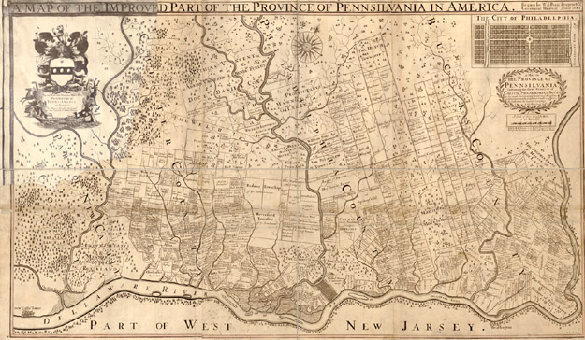
Unfortunately, disagreements over the borders of Pennsylvania and Delaware forced Penn to return to England in 1684. He was in England until 1699.

Slide 9
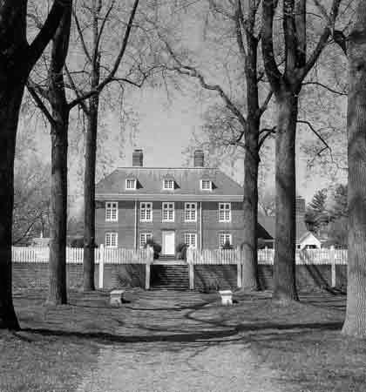
Penn returned to Pennsylvania and lived at Pennsbury Manor while he was in America. But once again, problems in England forced him to return in 1701.

Slide 10
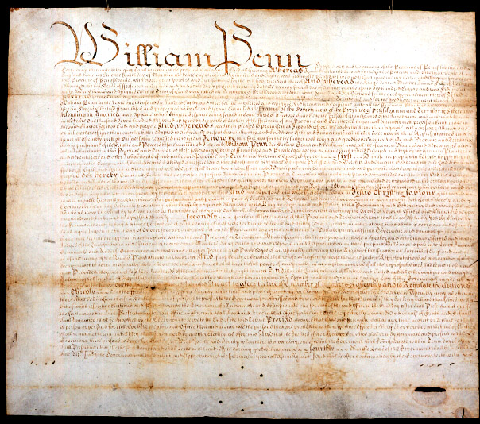
Also in 1701, Penn wrote the Charter of Privileges. It helped to give people more control over their government.

Slide 11
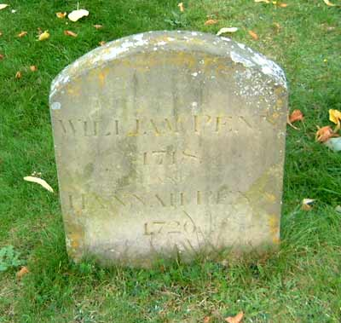
William Penn died in England on July 30, 1718.

Slide 12
Acrostic Poem
Using each letter in the word Pennsylvania, create an acrostic poem describing William Penn and how the colony of Pennsylvania was started.

